Slide 1
Head First Design Patterns
Chapter 1-4

Slide 2
Strategy Pattern
Chapter 1

Slide 3
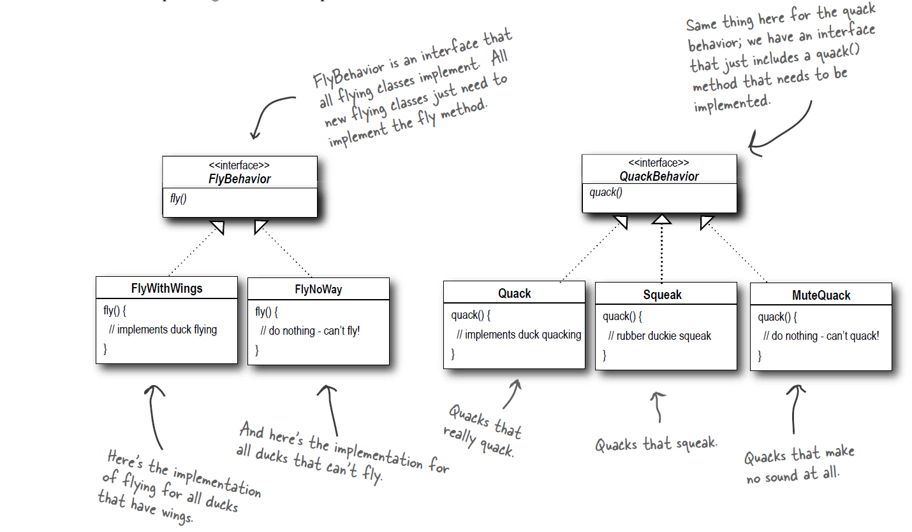

Slide 4
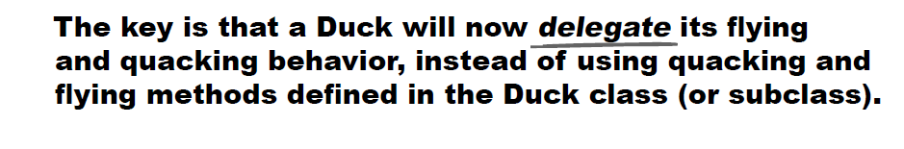
Strategy pattern
Behaviors of the ducks (the component that varies) is kept separately from the main object (duck) – Design principle: Identify what components change in your application, and keep that separate from what stays the same.
That way, Duck classes don’t need to know any of the implementation details for their own behaviors. Duck classes stay constant and behaviors can be added as and when required.

Slide 5
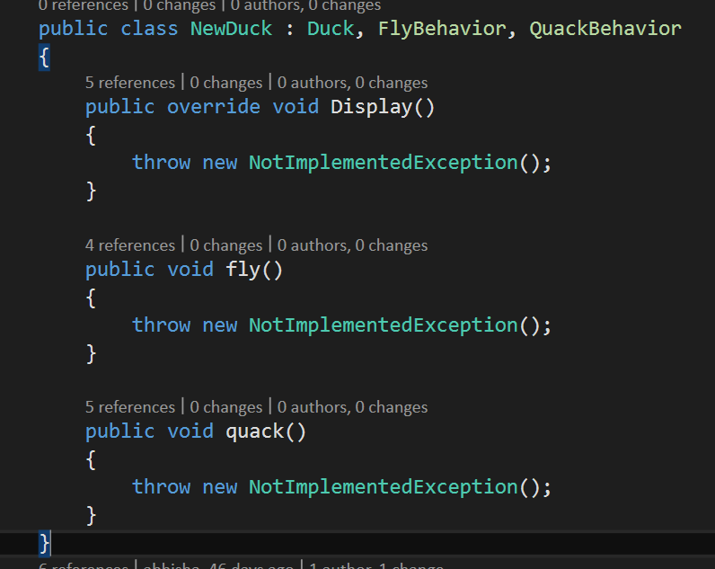
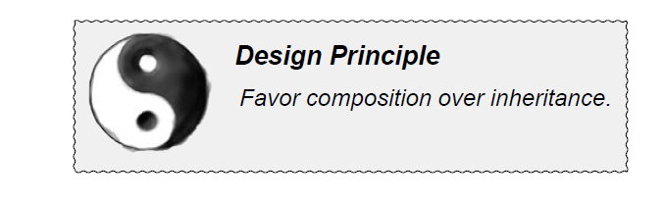
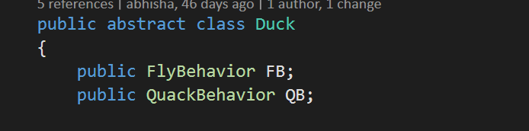
Strategy pattern – Why not have the different ducks implement multiple interfaces?
← Code duplication
← IS A relationship (bad)
HAS A relationship

Slide 6
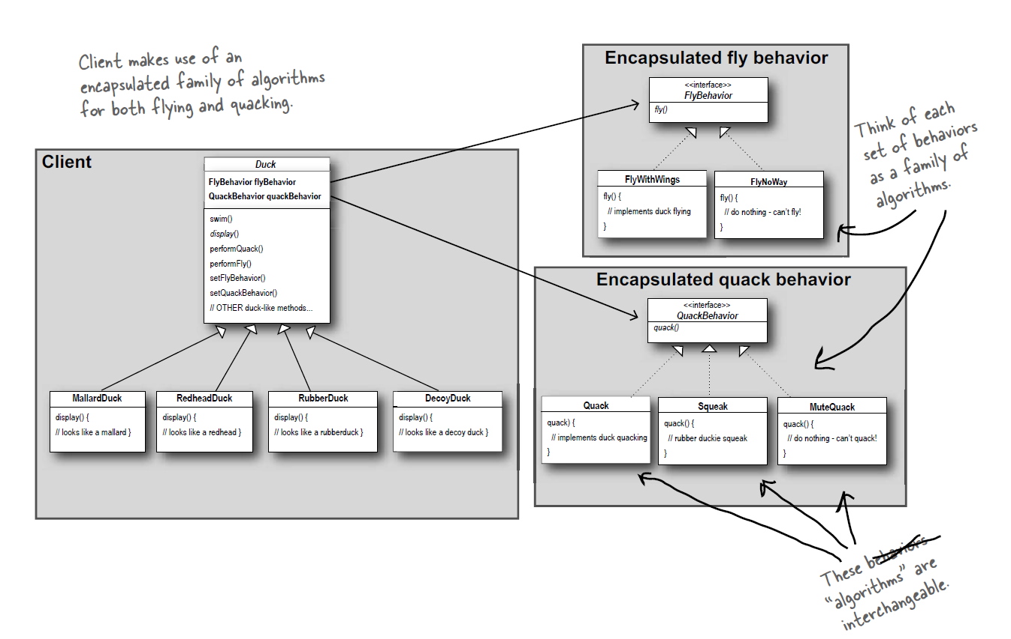

Slide 7
Observer Pattern
Chapter 2

Slide 8
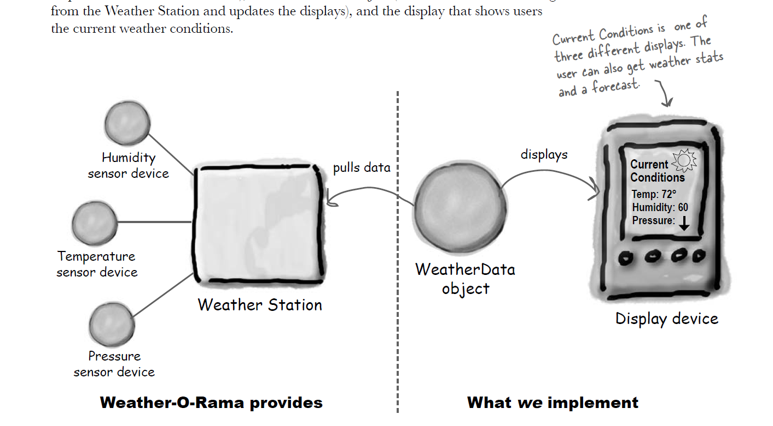
Observer Pattern
Overview
Chapter 2

Slide 9
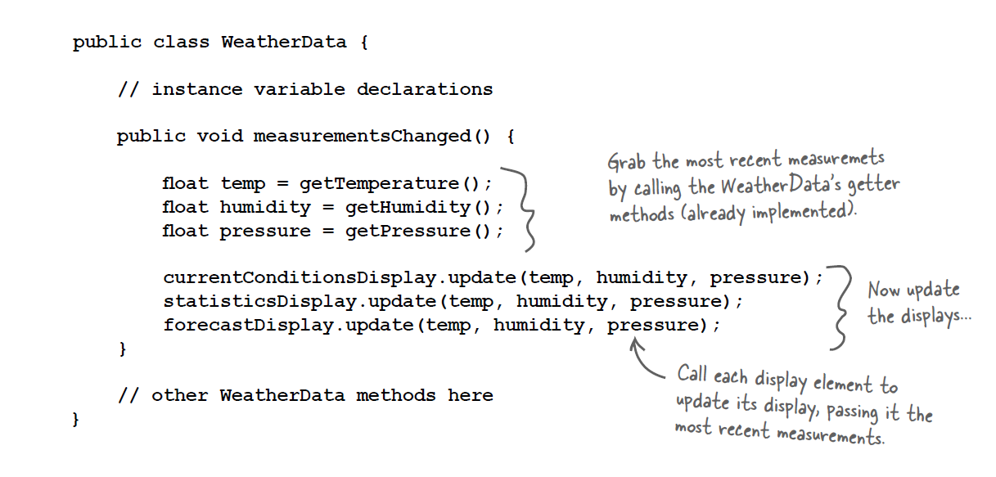
Observer pattern
Pub sub model (notifications whenever something happens) – first attempt

Slide 10
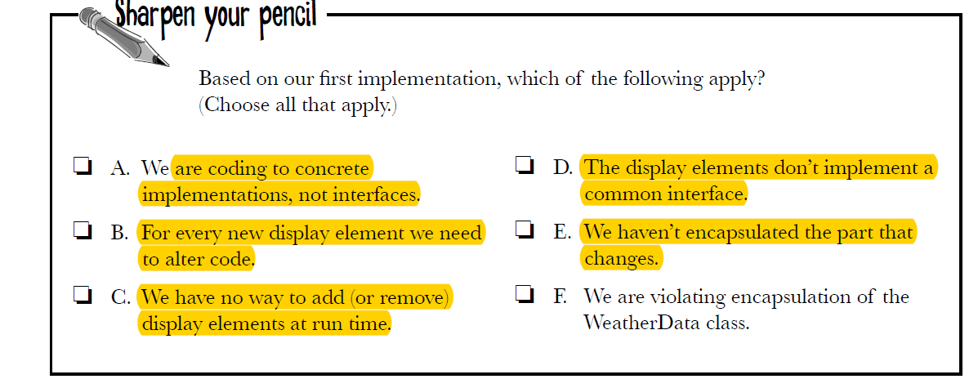
Observer pattern

Slide 11
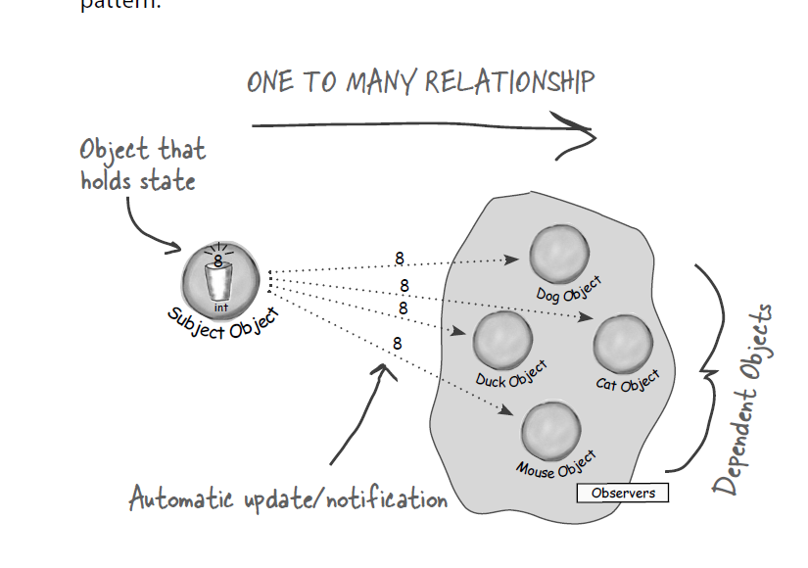
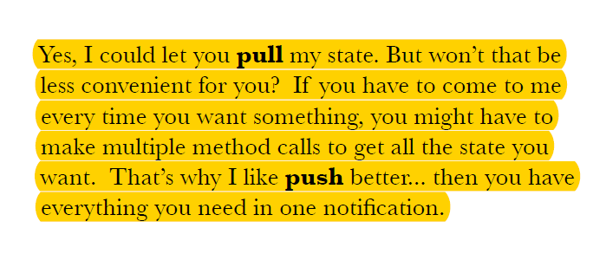
Observer pattern
Observers subscribe to a “subject” who is generating some events. If the subject generates some event which the observer has subscribed to, then the observer gets notified (think Facebook feed)
It is a one to many mapping

Slide 12
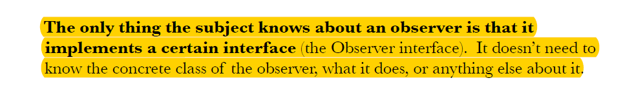
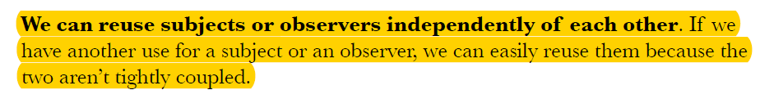
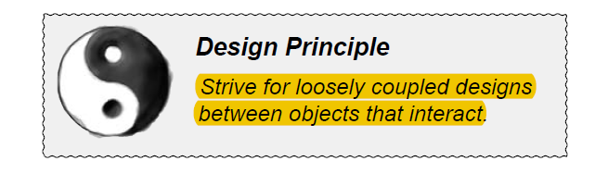
Observer pattern
Some interesting points
Promotes loose coupling:
Demo shows how easy it is to add new observers (as long as they implement the observer interface, they can be added)
Demo shows the subject has a list of observers – any time a new observer comes in, add to the list, that’s all
Observers have nothing to do with the subject other than they are subscribed to it

Slide 13
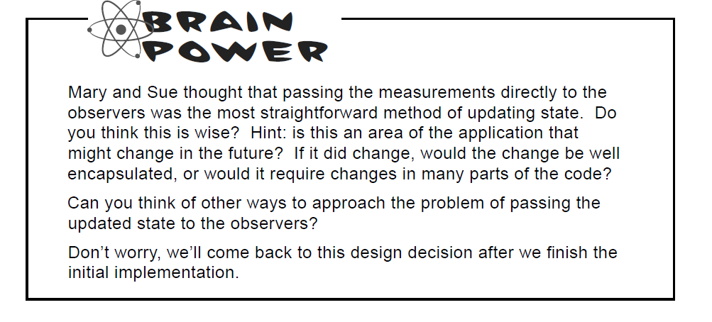
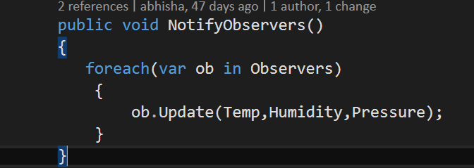
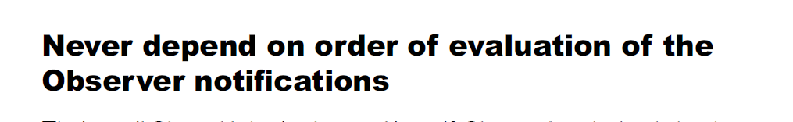
Observer pattern
Discussion – instead of using update to notify, directly assign values of temperature, humidity etc.?
SIDE NOTE

Slide 14
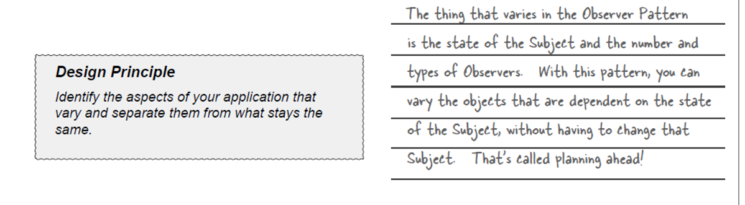
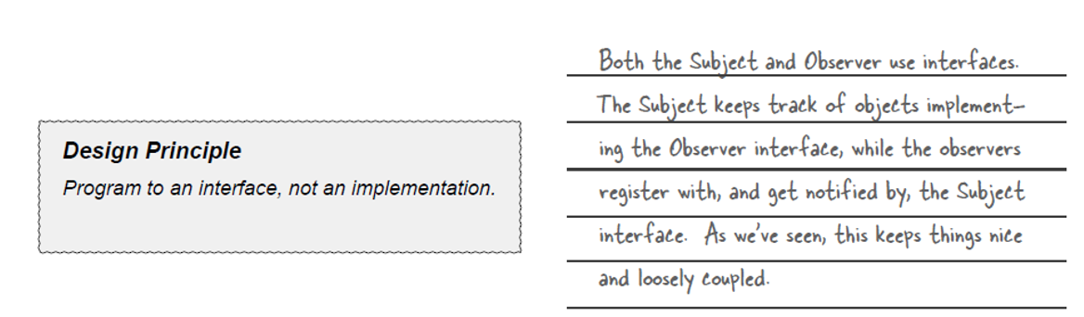
Observer pattern

Slide 15
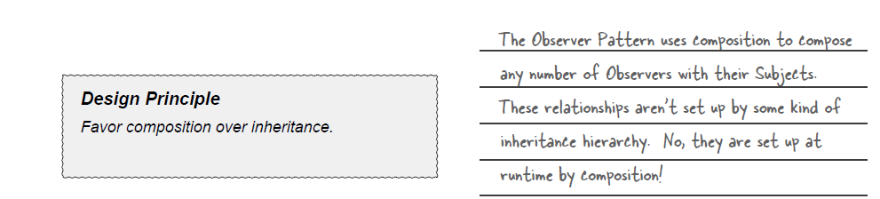
Observer pattern

Slide 16
Decorator Pattern
Chapter 3

Slide 17
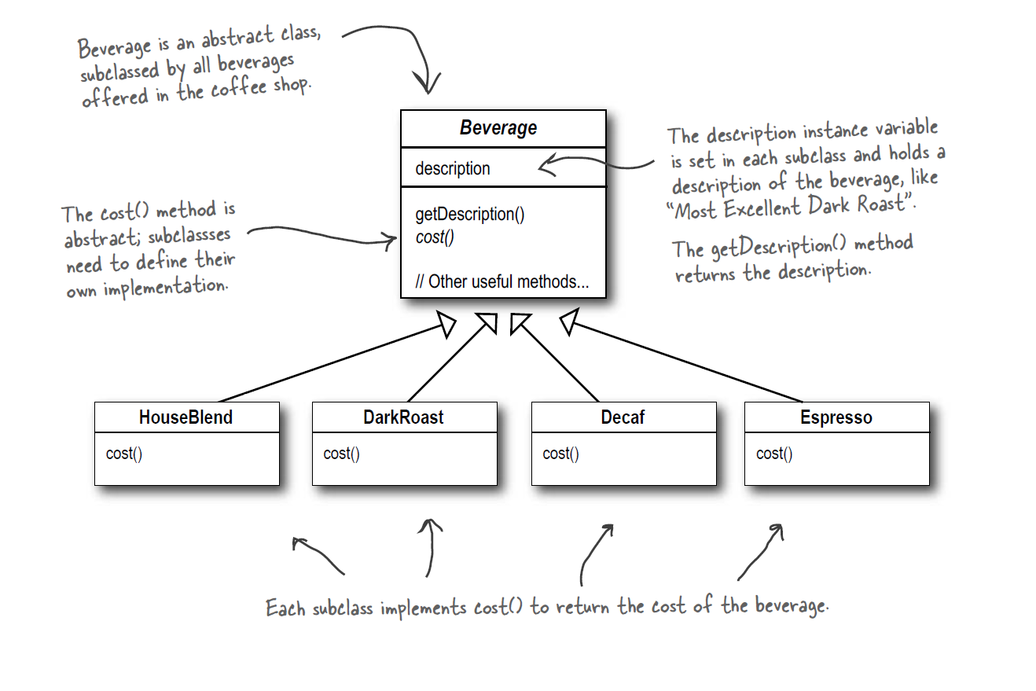
Decorator Pattern
Chapter 3

Slide 18
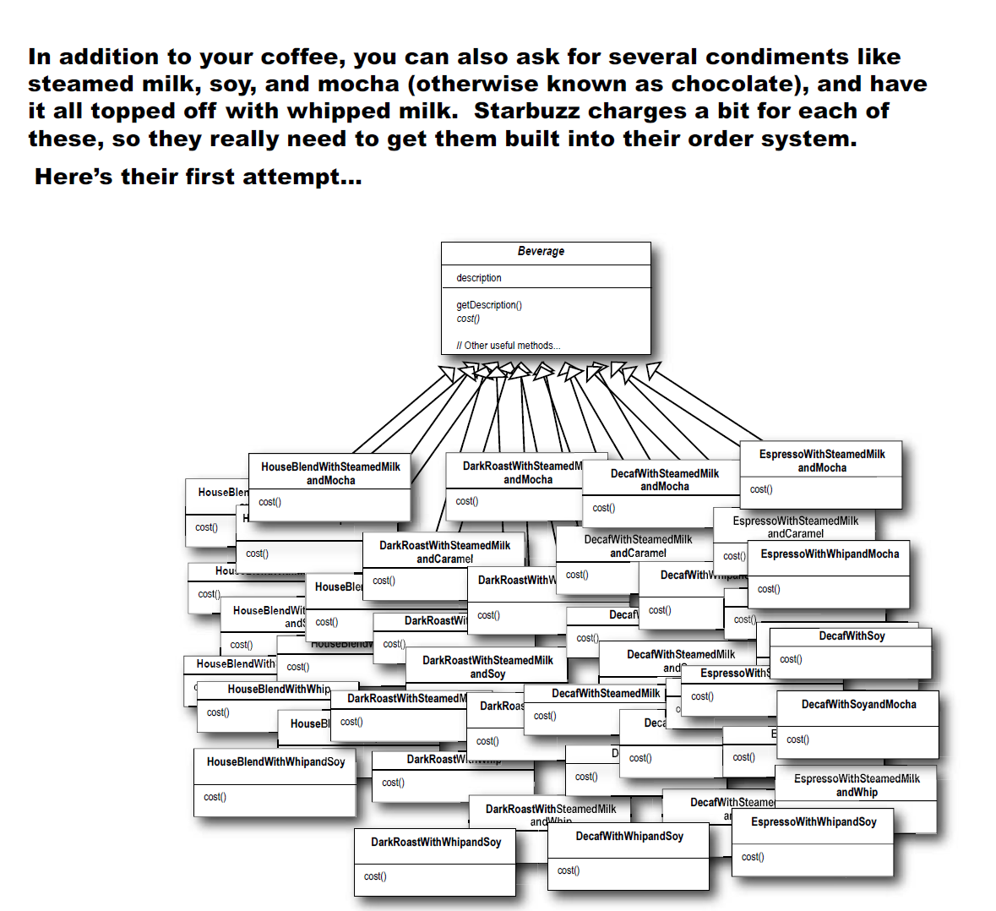
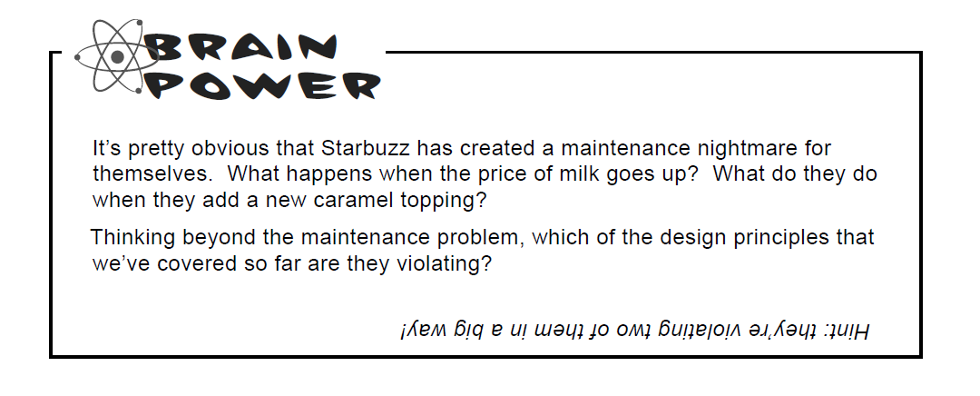
Decorator Pattern
Chapter 3

Slide 19
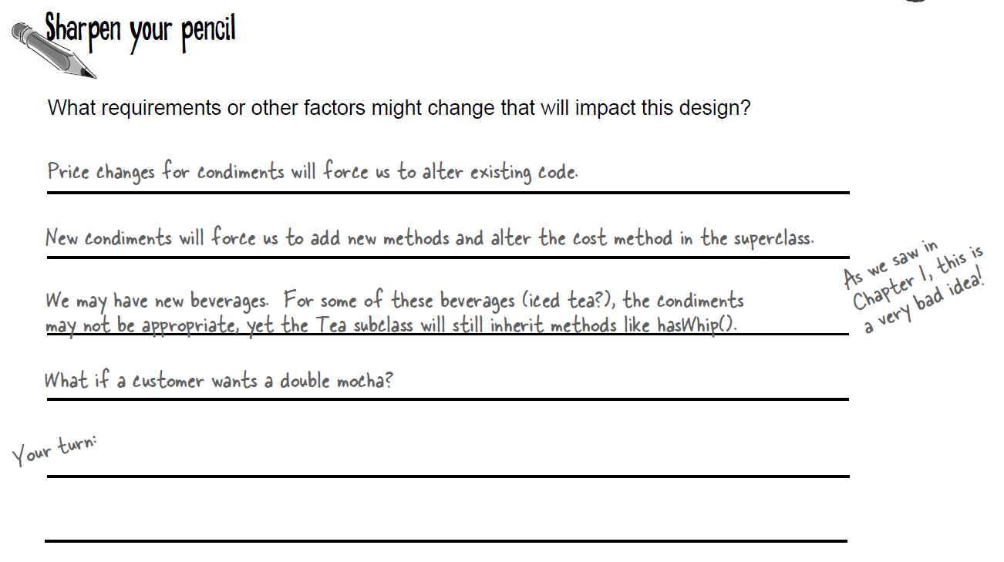
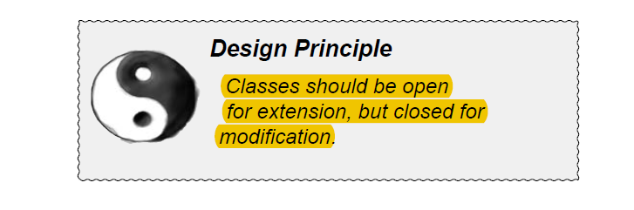
Decorator Pattern
Chapter 3

Slide 20
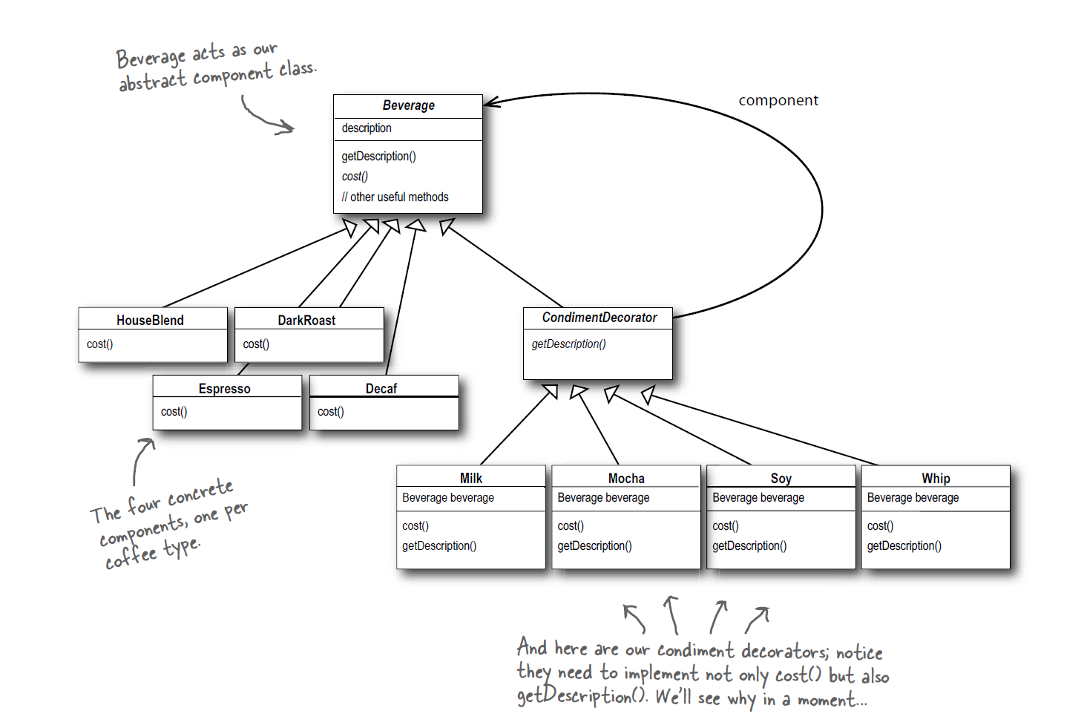
Decorator Pattern
Chapter 3

Slide 21
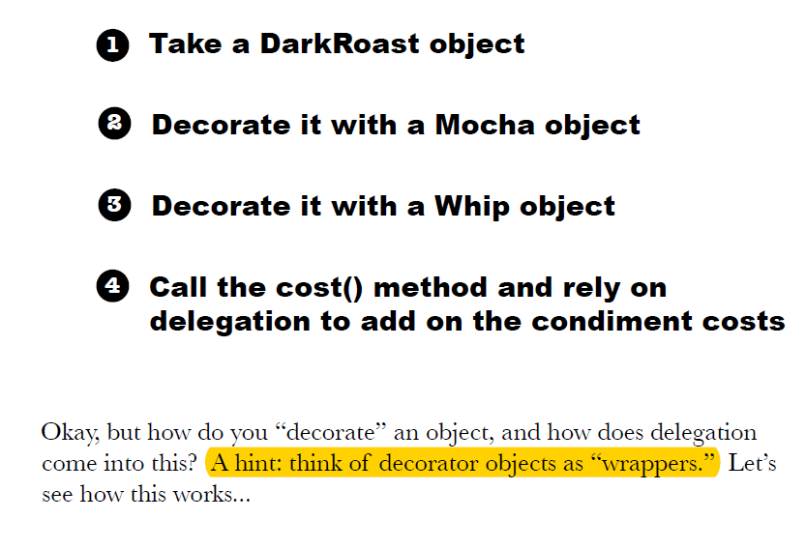
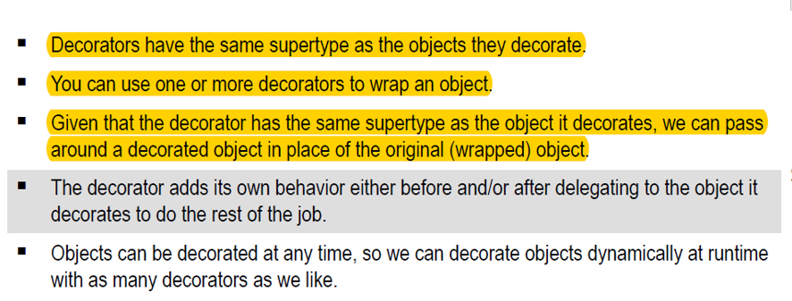
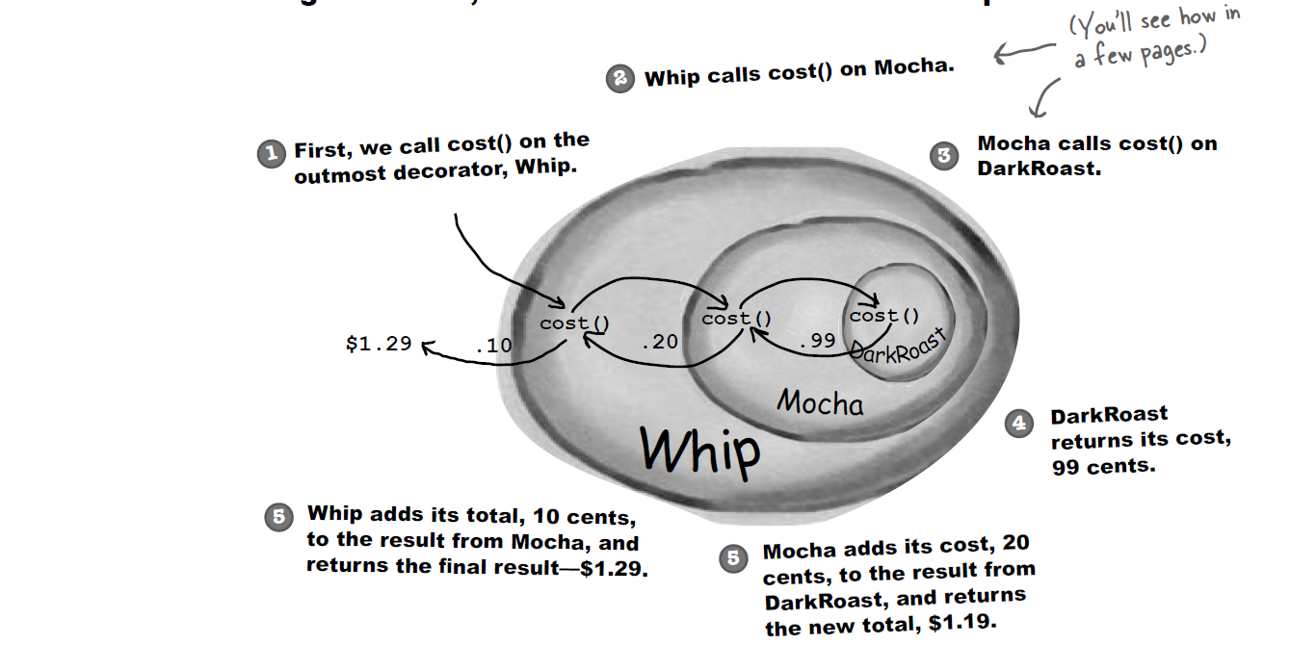
Decorator Pattern
Chapter 3

Slide 22
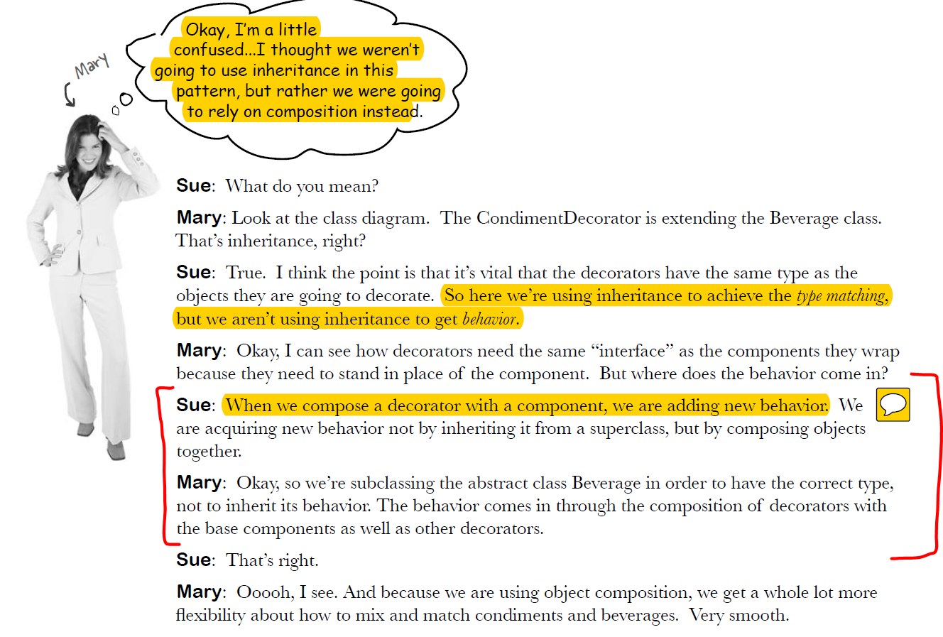
Decorator Pattern
Chapter 3

Slide 23
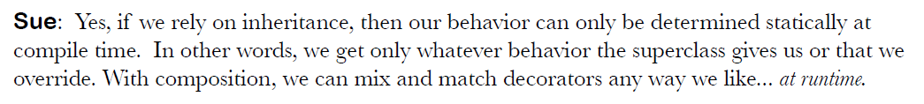
Decorator Pattern
Key Takeaway
In our demo, we will see:
The Mocha class is a subclass to be able to “decorate” the beverage class, its functionality (behavior) comes about due to the fact that it is using the existing beverage (from its constructor) and adding its own title/cost to this existing beverage and returning that as a “decorated” beverage object.

